Slide 1
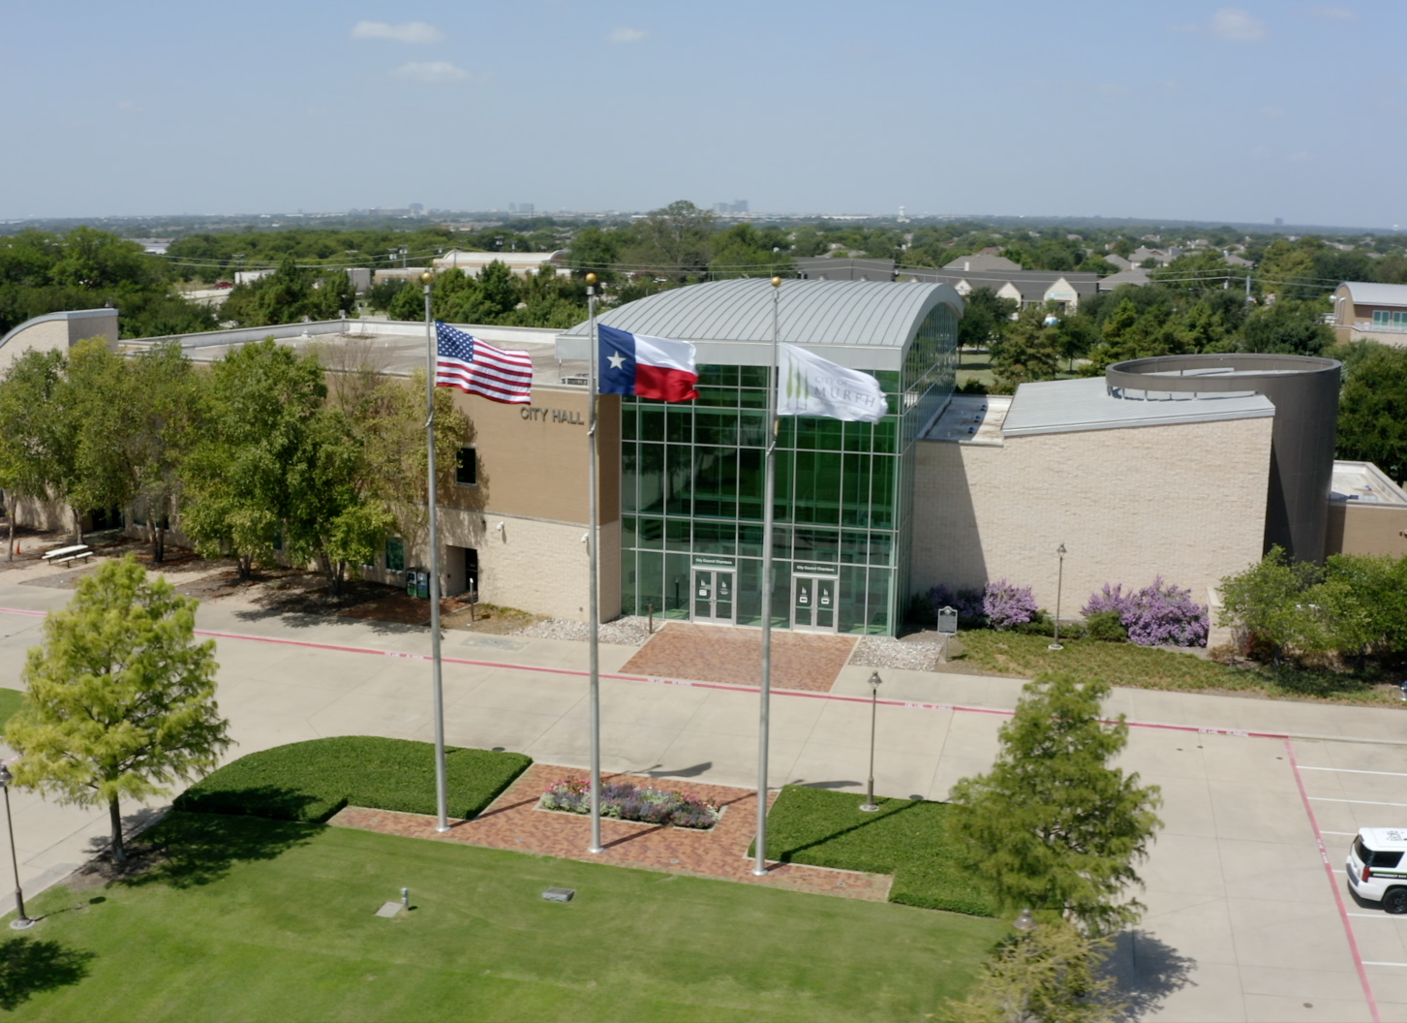
Quarterly
Financial Report
4th Quarter FY2025 (Unaudited)
November 4, 2025

Slide 2
4th Quarter FY 2025
Economic/Financial Condition Evaluation
Fiscal Management Contingency Plan
Comprehensive Financial Plan, page 26
Level I. Estimated Annual Revenue Below Budget Projections for 3 consecutive months? No
Yes = Begin Level I contingency plan process
No = No contingency action needed

Slide 3
4th Quarter FY 2025
Budget Tracking – Capital
City Manager will report any capital expenditures that varies more than $10,000
Customer Service = within range MCDC = within range
Facilities = within range Police = within range
Fire Dept = within range Recreation = within range
Fund 17 PEG = within range Water Distribution = within range
Fund 60 Capital Const = within range VERF = within range
Fund 65 Utility Const = within range
Notes:
Public Works: 80K - Transfer to engineering services from land waterline loops to cover engineering service overage
Fund 63: 78K – Transfer to prop A sidewalk connection to prop A Ped Bridge legal negotiations ROW
(MDD: 200K – 544 right turn lane HEB (design); 212,155 Toll Bro est from tot expenditure (3yrs were underestimated)

Slide 4
4th Quarter FY 2025
General Fund Sales Tax - 1 cent Monthly Collections Comparison
FY25 Budget – Gen. Fund Sales Tax | $2,933,684 | Actual to Budget % | 99.2% | Current Yr to Prior Yr (%) | -0.32%
FY25 YTD Actuals – Gen. Fund Sales Tax | $2,911,235 | Remaining Budget | $ 22,449 | Current Yr to Prior Yr ($) | $ (9,233)
Notes:
The report attached to the Agenda has all four funds that receive sales tax revenue. This slide only represents the General Fund component of the 1 cent sales tax revenue. The variance in FY24 in February to March is due the State Comptroller making a state-wide audit adjustment that impacted most cities in Texas, that was reversed the next month.

Slide 5
4th Quarter FY 2025
General Fund Revenue – FY25 vs FY24
Notes:
The Other Revenue

Slide 6
4th Quarter FY 2025
Expenditures by Department – FY25 vs FY24
Notes:
The Other uses in FY24 is the transfer to the Utility Fund for the waterline loop project. The Police department increase in FY24 is $600 of which is PO carry over for radios and vehicles, and $540k in personnel expenses. City Council is for the 380 Agreement.

Slide 7
4th Quarter FY 2025
All Funds Summary - 100% of Fiscal Year - Continued
16*: Fund 16 - Community Events negative fund balance. The MCDC approved transfer to Community Events is $678,966. The transfer will be recorded in January 2025 resulting in a positive fund balance. This fund covers expenses related to Community events and personnel services for 2 FTE's.

Slide 8
4th Quarter FY 2025
All Funds Summary –100% of Fiscal Year - Continued

Slide 9
4th Quarter FY 2025
All Funds Summary –100% of Fiscal Year

Slide 10
4th Quarter FY 2025
Capital Projects - Budget Summary
Project Name | Original Budget | FY25 Actual (as of 09/30/25) | Project to-date Activity | Budget Balance* | % Status of Phase as of 09/30/25 | Fund Source(s)
FM544 Pedestrian Bridge & Trail Connection | 4,776,650 | 252,479 | 673,130 | 4,103,520 | 95% Design | '19 GO Bonds, '20 &'22 Tax Notes, MDD, TXDOT
FM544 Pedestrian Bridge & Trails project - "Proposition D for Trails Unspent" | 323,350 | - | - | 323,350 | 95% Design | Surety Proceeds from Proposition D & Interest
"Timbers Trail Sidewalk" McCreary to S. Maxwell Creek Rd Trail to Sachse | 600,000 | 479,513 | 594,088 | 5,912 | 100% Complete | MCDC
FM544 S. Murphy Rd - Medians & Landscaping | 1,826,800 | 1,025,619 | 1,044,443 | 782,357 | 100% Complete | MDD & MCDC
Crescent Hill Improvements | 842,484 | 1,042,376 | 1,042,376 | -0- | 100% Complete | MDD
Waterline Loops Project | 5,089,651 | 11,496 | 1,662,627 | 3,427,024 | 100% Design/0% Construction | Util Fund(Const), Gen Fund (Land), ARP Fund (encumbrances)
Gables Pavement Rehabilitation | 53,847 | 20,020 | 20,020 | 33,827 | 37.2% Complete | Gables Escrow
Notes:
We welcome any feedback for formatting, and visualizations, as ”in a format prescribed by Council”

Slide 11
4th Quarter FY 2025
Capital Projects - Budget Summary Continued
Project Name | Original Budget | FY25 Actual (as of 09/30/25) | Project to-date Activity | Budget Balance* | % Status of Phase as of 09/30/25 | Fund Source(s)
Oak Glen to Ridgestone water line replacement FY26 | 98,650 | - | - | 98,650 | 0% | '18 Util. COs Unspent
Woodcrest to Rocky Glen water line replacement FY26 | 98,650 | - | - | 98,650 | 0% | '18 Util. COs Unspent
Bunny Run (S. Maxwell Crk westerly to Timbers Nature Preserve)water line replacement FY26 | 98,651 | - | - | 98,651 | 0% | '18 Util. COs Unspent
Hawthorn Pump Station FY26 | 100,000 | - | - | 100,000 | 0% | '18 Util. COs Unspent
200 Block Oak Bluff Water Mains/Sanitary Sewer FY25 | 250,000 | - | - | 250,000 | 0% | '18 Util. COs Unspent
100 Block Post rest, 400 Block Walnut Water Mains/Sanitary Sewer FY25 | 250,000 | - | - | 250,000 | 0% | '18 Util. COs Unspent
Notes:
We welcome any feedback for formatting, and visualizations, as ”in a format prescribed by Council”

Slide 12
4th Quarter FY 2025
Capital Projects - Budget Summary Continued
Project Name | Original Budget | FY25 Actual (as of 09/30/25) | Project to-date Activity | Budget Balance* | % Status of Phase as of 09/30/25 | Fund Source(s)
Skyline Drive (Horizon Dr. to S. Murphy Road) including water mains and sanitary sewer FY26 | 175,481 | - | - | 175,481 | 0% | '18 Util. COs Unspent
Water Distribution Service Line Replacements (FY26) – 2018 CO | 970,714 | - | - | 970,714 | 0% | '18 Util. COs Unspent
Kinney Waterline Replacement | 700,000 | 11,541 | 413,744 | 286,256 | 100% Design completion; 75% Construction | Utility Fund
Total | 16,254,928 | 2,843,044 | 5,450,428 | 11,004,392
Notes:
We welcome any feedback for formatting, and visualizations, as ”in a format prescribed by Council”

Slide 13
4th Quarter FY 2025
FY25 Capital Project Expenditures

Slide 14
Questions??
Finance Department

